Slide 1
Pop art
Art movement

Slide 2
Beginnings
Pop art is an art movement that emerged in the mid-1950s in Britain and the late 1950s in the United States.

Slide 3
Basic characteristics
Pop art presented a challenge to traditions of fine art by including imagery from popular culture such as advertising and news.
In pop art, material is sometimes visually removed from its known context, isolated, and/or combined with unrelated material.
One of its aims is to use images of popular (as opposed to elitist) culture in art, emphasizing the banal or kitschy elements of any culture, most often through the use of irony.
It is also associated with the artists' use of mechanical means of reproduction or rendering techniques.

Slide 4
Main pop artists
Eduardo Paolozzi,
Richard Hamilton,
Robert Rauschenberg,
Jasper Johns.

Slide 5
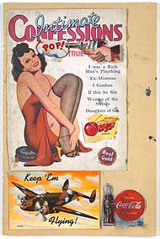
Eduardo Paolozzi

Slide 6
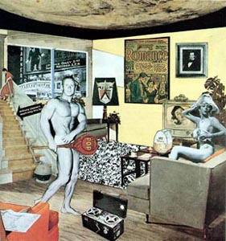
Richard Hamilton

Slide 7
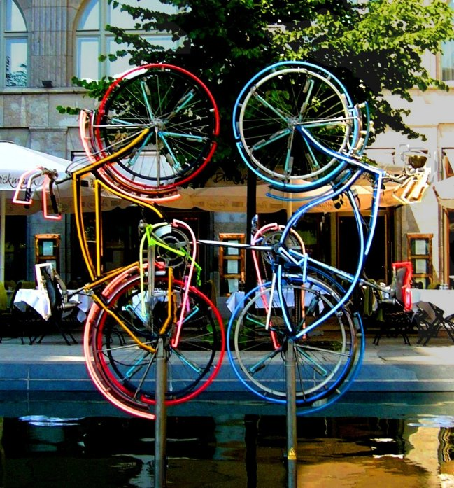
Robert Rauschenberg

Slide 8
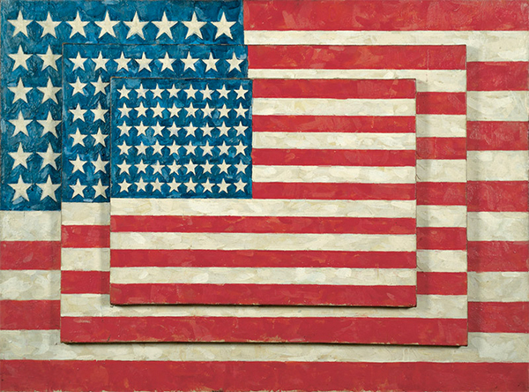
Jasper Johns

